Slide 1
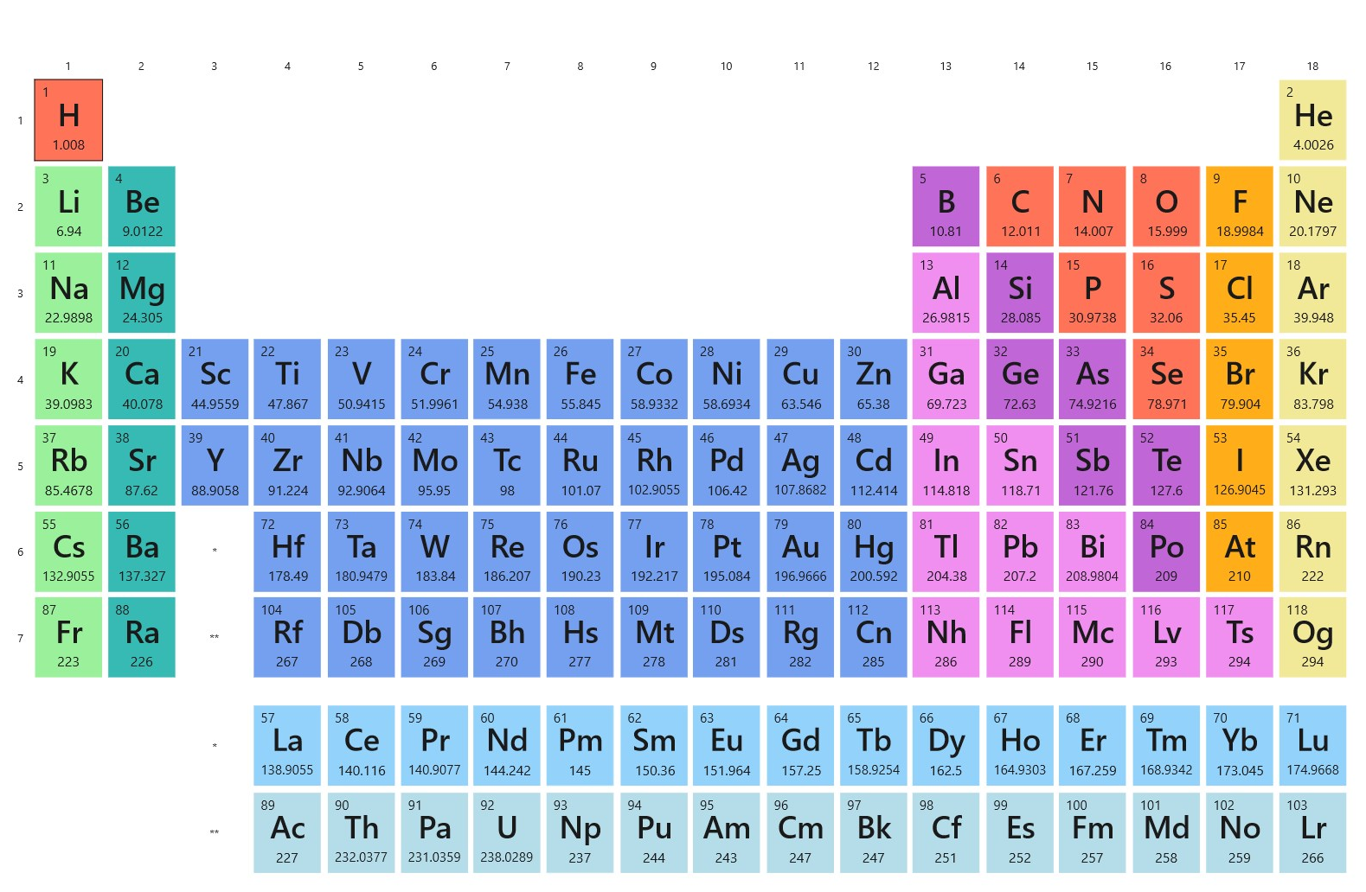
The Periodic Table periodic properties

Slide 2
Dmitri Mendeleev (1869)
In 1869 Mendeleev and Lothar Meyer (Germany) published nearly identical classification schemes for elements known to date. The periodic table is base on the similarity of properties and reactivities exhibited by certain elements. Later, Henri Moseley ( England,1887-1915) established that each elements has a unique atomic number, which is how the current periodic table is organized.

Slide 3
The Periodic Table
A map of the building block of matter.

Slide 4
Periodic Table Expanded View
The way the periodic table usually seen is a compress view, placing the Lanthanides and actinides at the bottom of the stable.
The Periodic Table can be arrange by subshells.

Slide 5
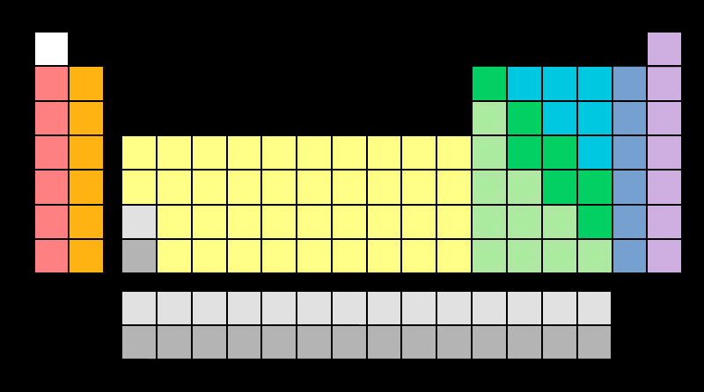
Periodic Table: simple organization

Slide 6
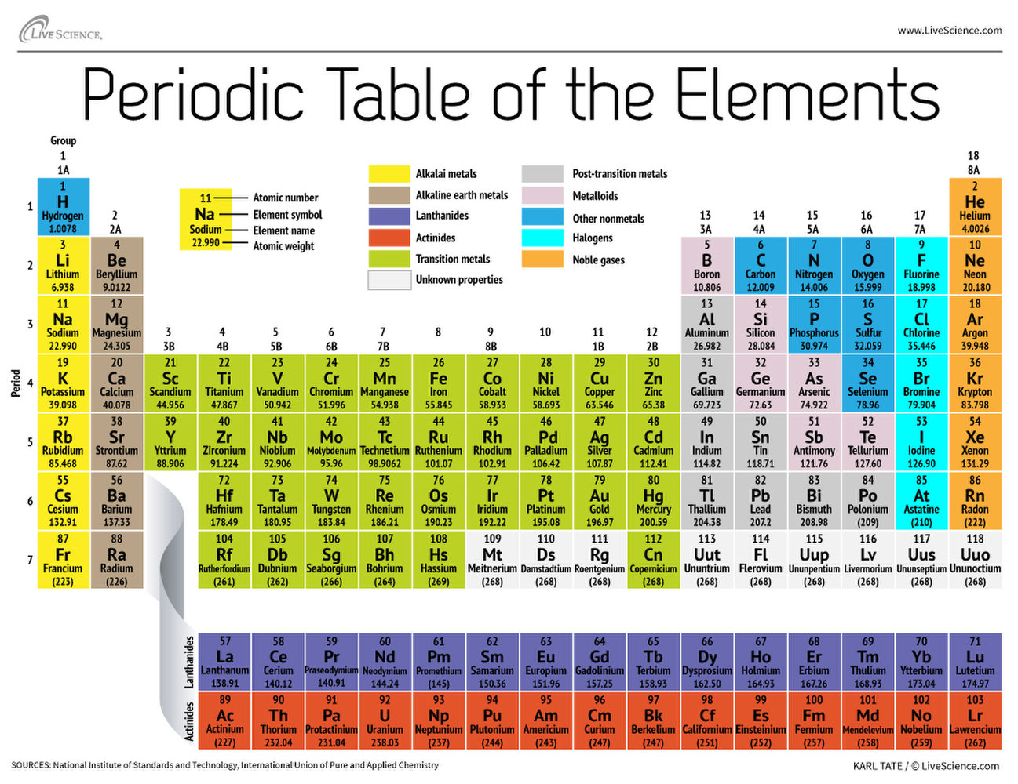
Reading the Periodic Table: Classification
Nonmetals, Metals, Metalloids, Noble gases

Slide 7
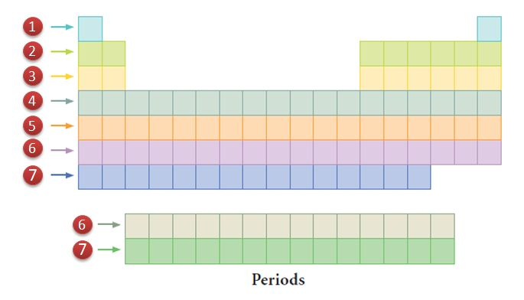
Periodic table: periods

Slide 8
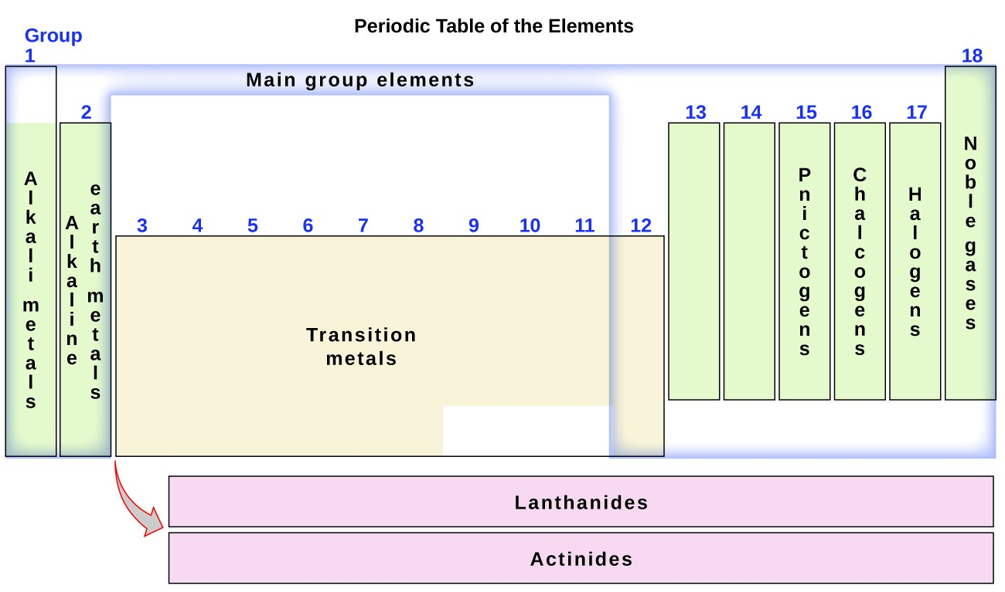
Down the Periodic Table: groups

Slide 9
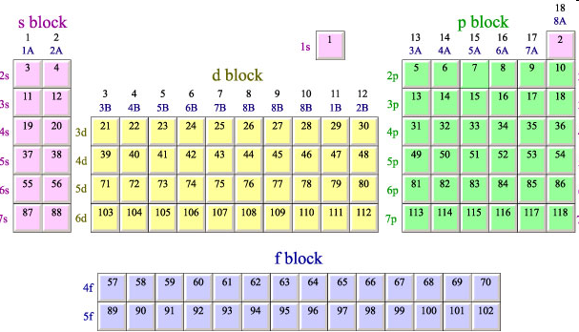
The spdf Blocks of Periodic Table

Slide 10
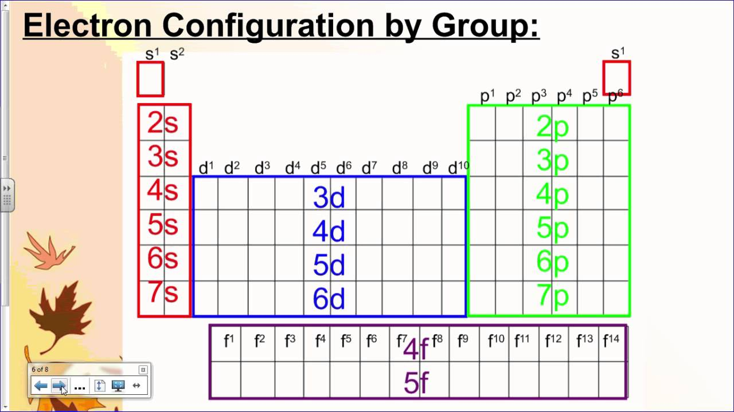
Periodic Table e⁻ configuration from the periodic periodic table

Slide 11
Periodic Table e⁻ configuration from the periodic periodic table
H
1s¹
He
1s²
Be
2s²
B
2p¹
B
2p¹
F
2p⁵
Li
2s¹
C
2p²
N
2p³
O
2p⁴
Ne
2p⁶
Na
3s¹
Mg
3s²
Al
3p¹
Si
3p²
P
3p³
S
3p⁴
Cl
3p⁵
Ar
3p⁶
K
4s¹
Ca
4s²
Sc
3d¹
Ti
3d²
V
3d³
Cr
4s¹3d⁵
Mn
3d⁵
Fe
3d⁶
Co
3d⁷
Ni
3d⁸
Cu
4s¹3d¹⁰
Zn
3d¹⁰
Ga
4p¹
Ge
4p²
As
4p³
Se
4p⁴
Be
4p⁵
Kr
4p⁶
Rb
5s¹
Sr
5s²
Y
4d¹
Zr
4d²
Nb
4d³
Mo
5s¹4d⁵
Tc
4d⁵
Ru
4d⁶
Rh
4d⁷
Ni
4d⁸
Ag
5s¹4d¹⁰
Cd
4d¹⁰
In
5p¹
Sn
5p²
Sb
5p³
Te
5p⁴
I
5p⁵
Xe
5p⁶
Cs
6s¹
Ba
6s²
La
5d¹
Hf
5d²
Ta
5d³
W
6s¹5d⁵
Re
5d⁵
Os
5d⁶
Ir
5d⁷
Ni
5d⁸
Au
6s¹5d¹⁰
Hg
5d¹⁰
Tl
6p¹
Pb
6p²
Bi
6p³
Po
6p⁴
At
6p⁵
Rn
6p⁶
Fr
7s¹
Ra
7s²
Ac
6d¹
Rf
6d²
Db
6d³
Sg
7s¹6d⁵
Bh
6d⁵
Hs
6d⁶
Mt
6d⁷

Slide 12
Periodic properties
Effective nuclear charge
Atomic Radious
Ionization energy
Electron affinity

Slide 13
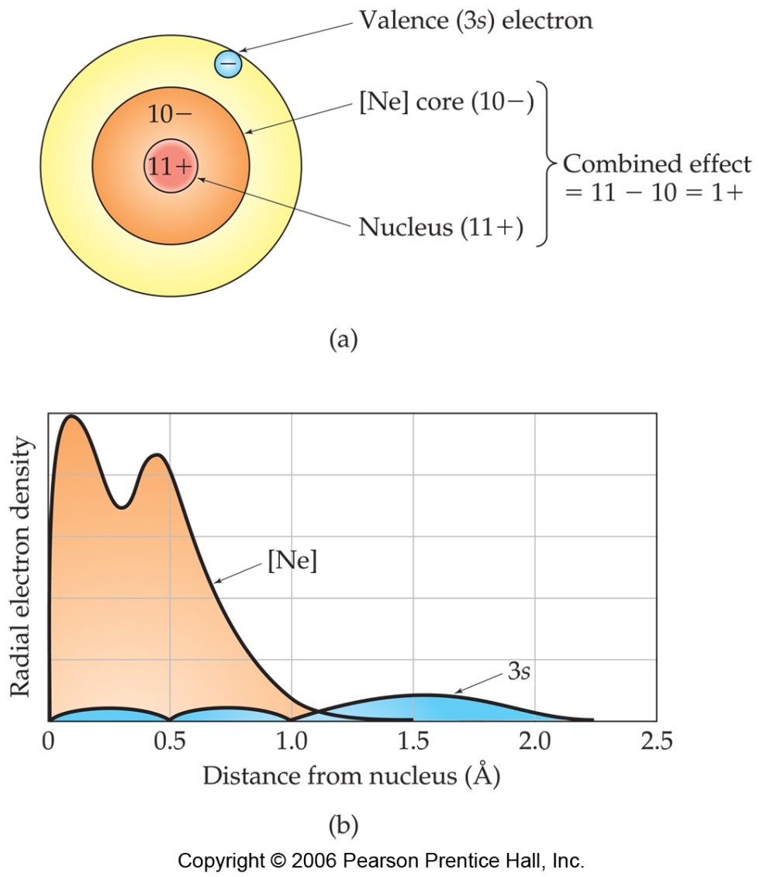
Effective Nuclear Charge
In a many-electron atom, electrons are both attracted to the nucleus and repelled by other electrons.
The nuclear charge that an electron experiences depends on both factors.

Slide 14
Effective Nuclear Charge
The effective nuclear charge, Z_{eff}, is found this way:
Z_{eff} = Z − S
where Z is the atomic number and S is a screening constant, usually close to the number of inner electrons.

Slide 15
Trend in Atomic Radius
Atomic Radius:
The size of at atomic specie as determine by the boundaries of the valence e-. Largest atomic species are those found in the SW corner since these atoms have the largest n, but the smallest Z_{eff}.

Slide 16
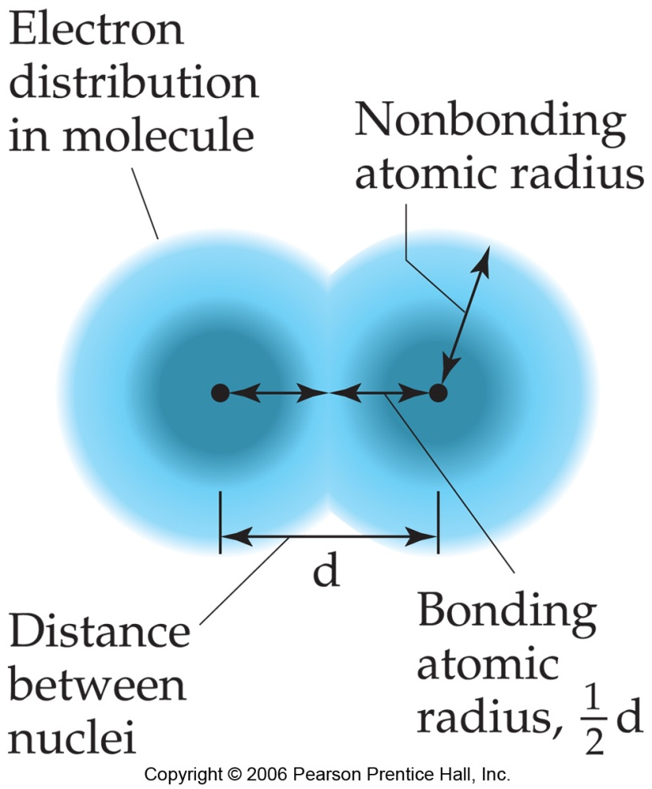
What Is the Size of an Atom?
The bonding atomic radius is defined as one-half of the distance between covalently bonded nuclei.

Slide 17
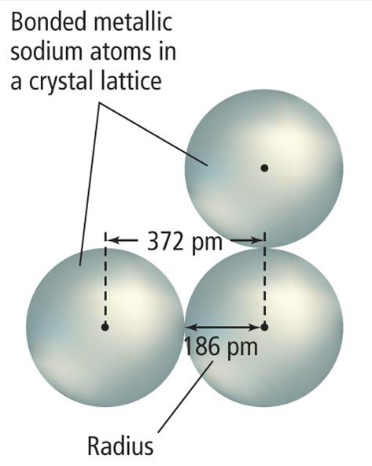
Atomic Radius
Atomic size is a periodic trend influenced by electron configuration.
For metals, atomic radius is half the distance between adjacent nuclei in a crystal of the element.

Slide 18
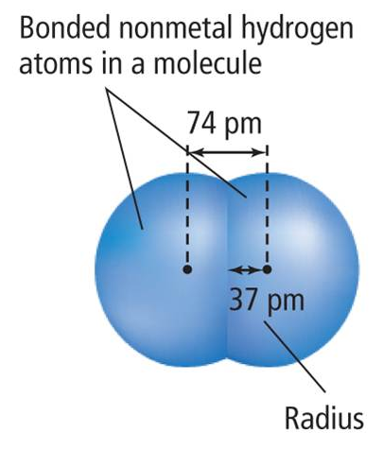
Atomic Radius
For elements that occur as molecules, the atomic radius is half the distance between nuclei of identical atoms that are chemically bonded together.

Slide 19
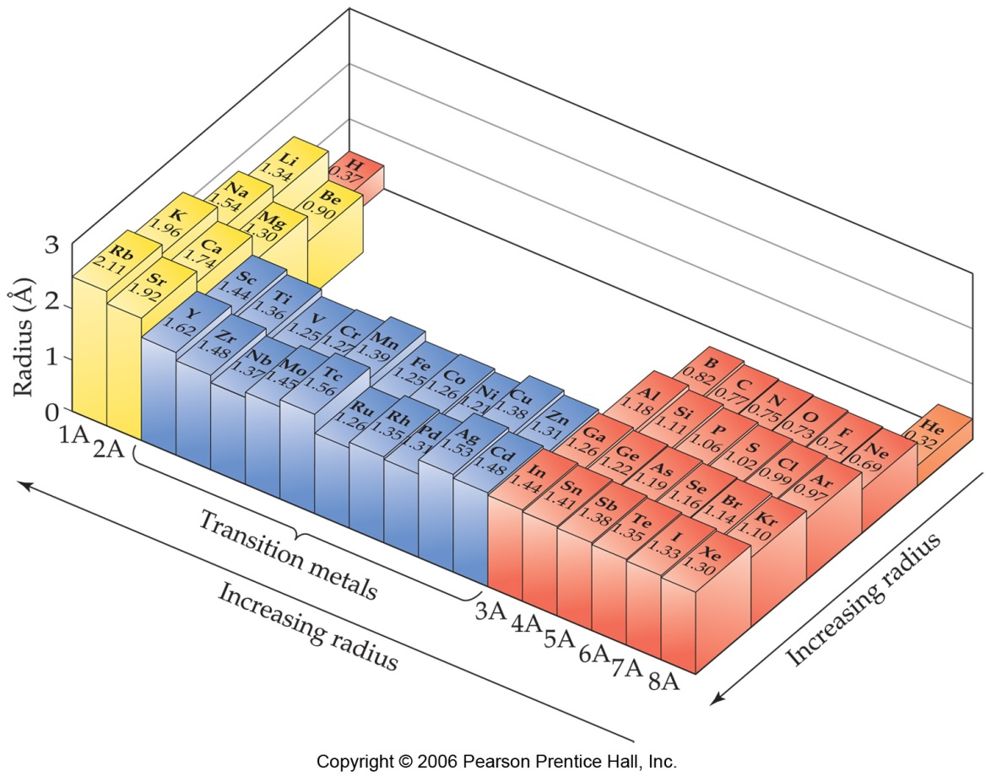
Sizes of Atoms

Slide 20
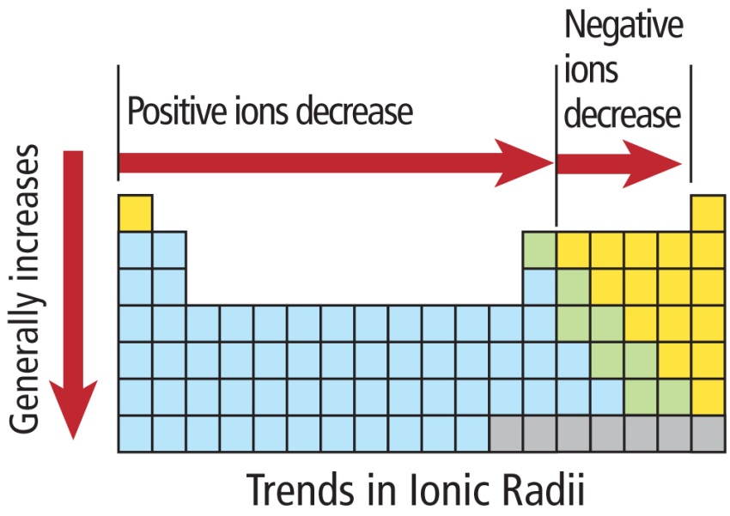
Ionic Radius
The ionic radii positive ions (cations) generally decrease from left to right.
The ionic radii of negative ions (anions) generally decrease from left to right, beginning with group 15 or 16.
Both positive and negative ions increase in size moving down a group.

Slide 21
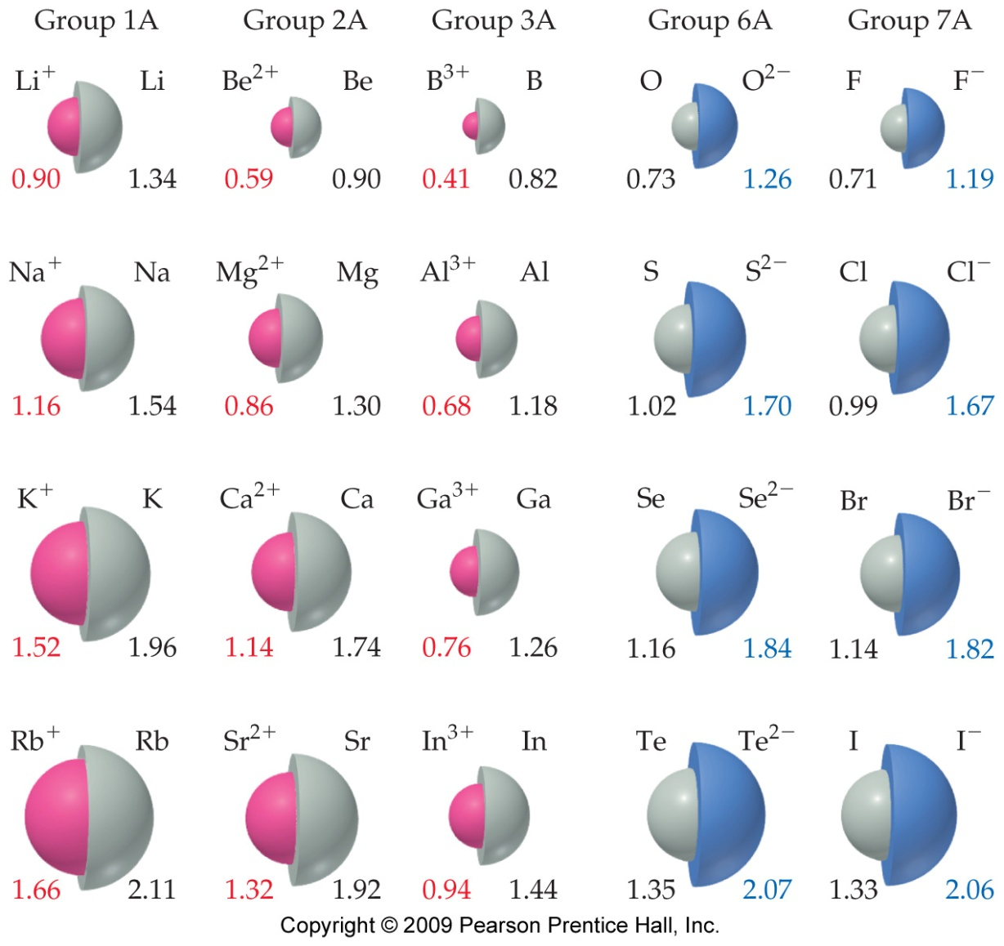
Sizes of Ions
Ionic size depends upon:
  The nuclear charge.
  The number of electrons.
  The orbitals in which electrons reside.

Slide 22
Sizes of Ions
Cations are smaller than their parent atoms.
  The outermost electron is removed and repulsions between electrons are reduced.

Slide 23
Sizes of Ions
Anions are larger than their parent atoms.
  Electrons are added and repulsions between electrons are increased.

Slide 24
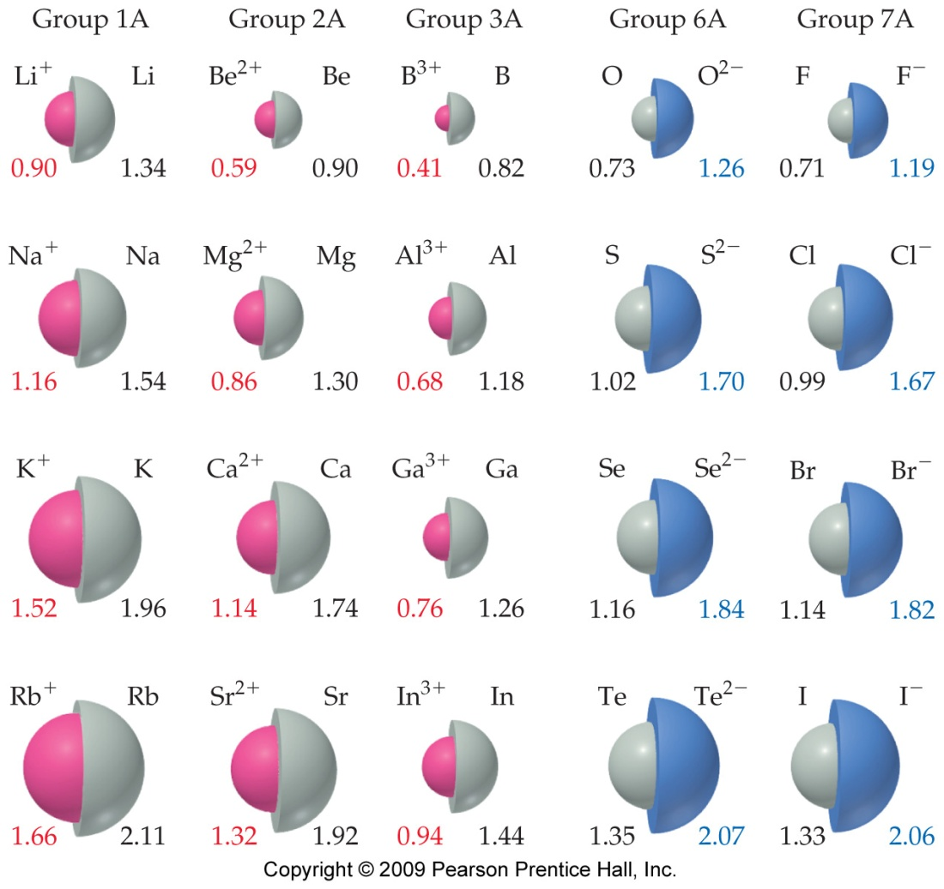
Sizes of Ions
Ions increase in size as you go down a column.
  This is due to increasing value of n.

Slide 25
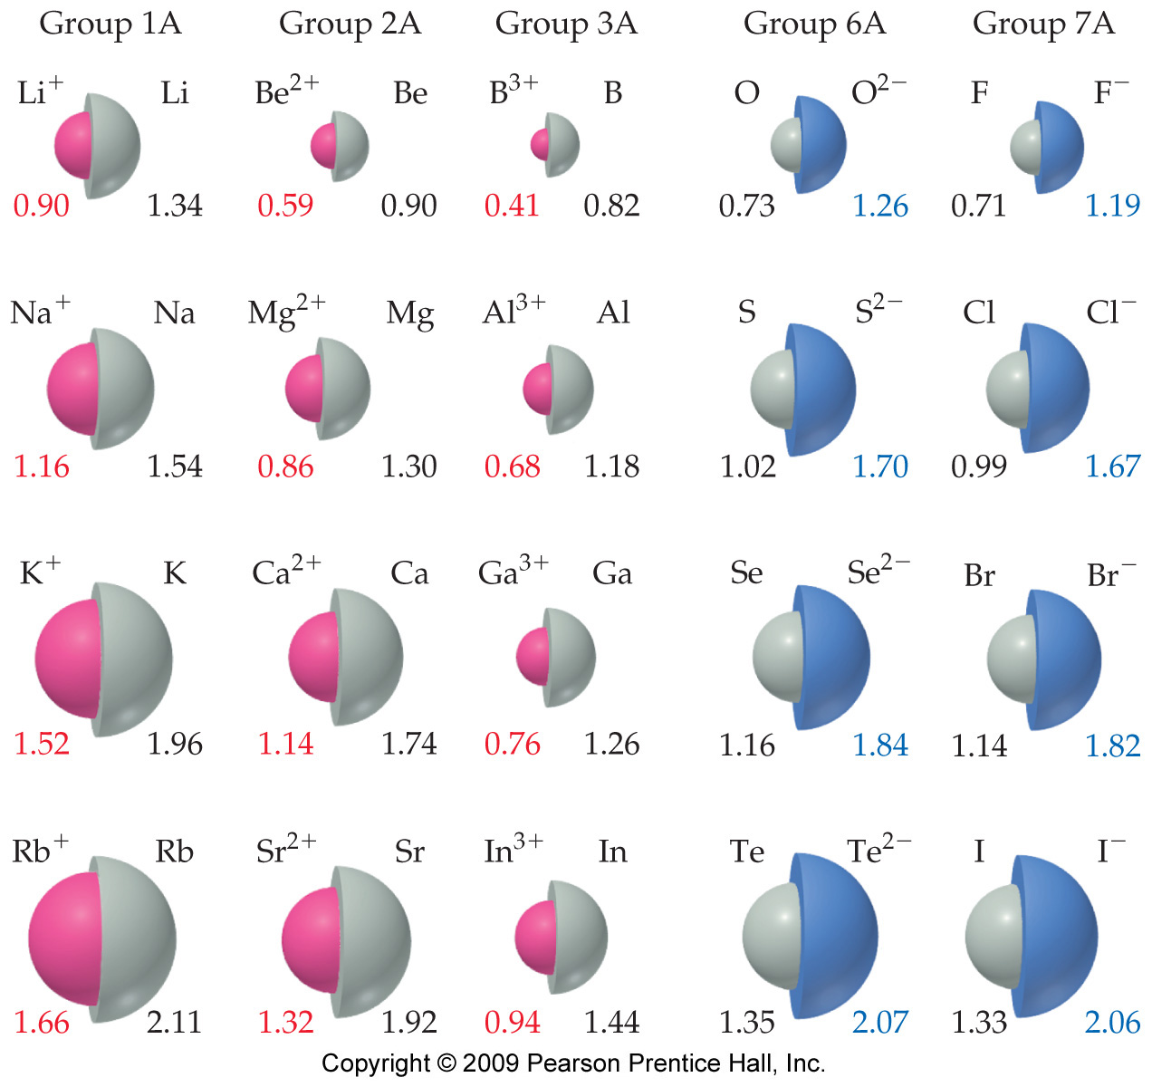
Sizes of Ions
In an isoelectronic series, ions have the same number of electrons.
Ionic size decreases with an increasing nuclear charge.

Slide 26
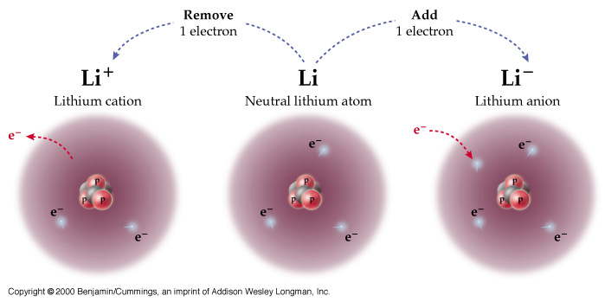
Trend in Ionization Potential
The energy required to remove the valence electron from an atomic specie. Largest toward NE corner of PT since these atoms hold on to their valence e- the tightest.

Slide 27
Ionization Energy
The ionization energy is the amount of energy required to remove an electron from the ground state of a gaseous atom or ion.
  The first ionization energy is that energy required to remove first electron.
  The second ionization energy is that energy required to remove second electron, etc.

Slide 28
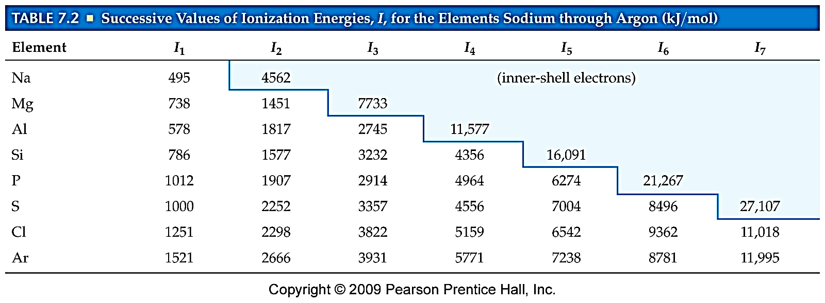
Ionization Energy
It requires more energy to remove each successive electron.
When all valence electrons have been removed, the ionization energy takes a quantum leap.

Slide 29
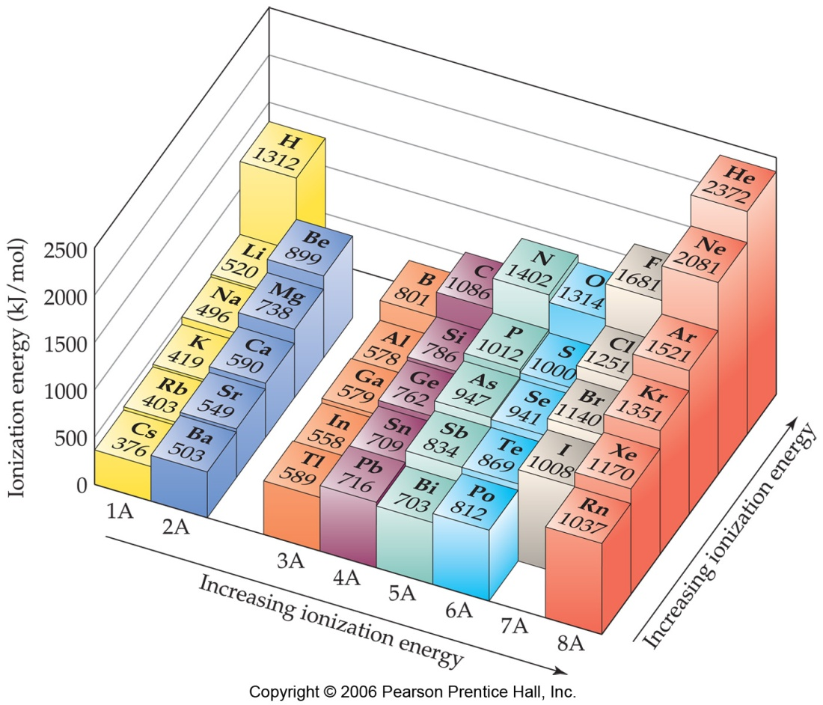
Trends in First Ionization Energies
  For atoms in the same group, Z_{eff} is essentially the same, but the valence electrons are farther from the nucleus.

Slide 30
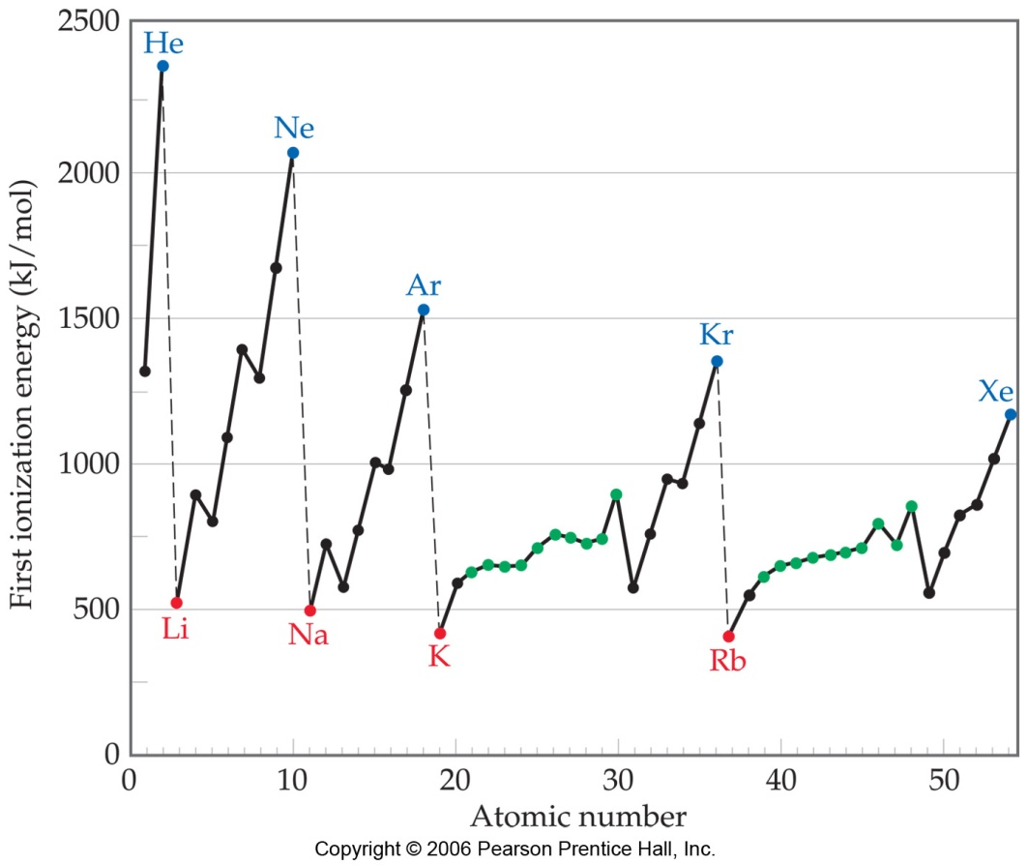
Trends in First Ionization Energies
Generally, as one goes across a row, it gets harder to remove an electron.
  As you go from left to right, Z_{eff} increases.

Slide 31
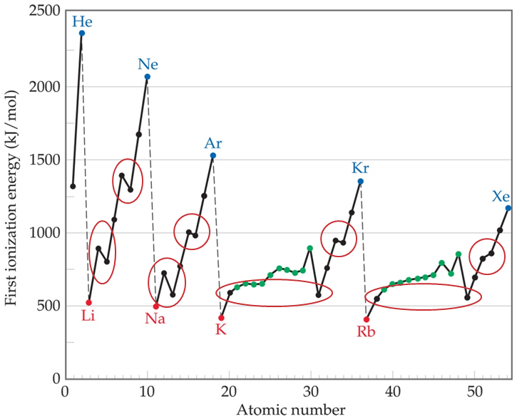
Trends in First Ionization Energies
However, there are two apparent discontinuities in this trend.

Slide 32
Trends in First Ionization Energies
The first occurs between Groups IIA and IIIA.
In this case the electron is removed from a p-orbital rather than an s-orbital.
  The electron removed is farther from nucleus.
  There is also a small amount of repulsion by the s electrons.

Slide 33
Trends in First Ionization Energies
The second occurs between Groups VA and VIA.
  The electron removed comes from doubly occupied orbital.
  Repulsion from the other electron in the orbital aids in its removal.

Slide 34
Trend in Electron Affinity
Electron Affinity:
The energy release when an electron is added to an atom. Most favorable toward NE corner of PT since these atoms have a great affinity for e-.

Slide 35
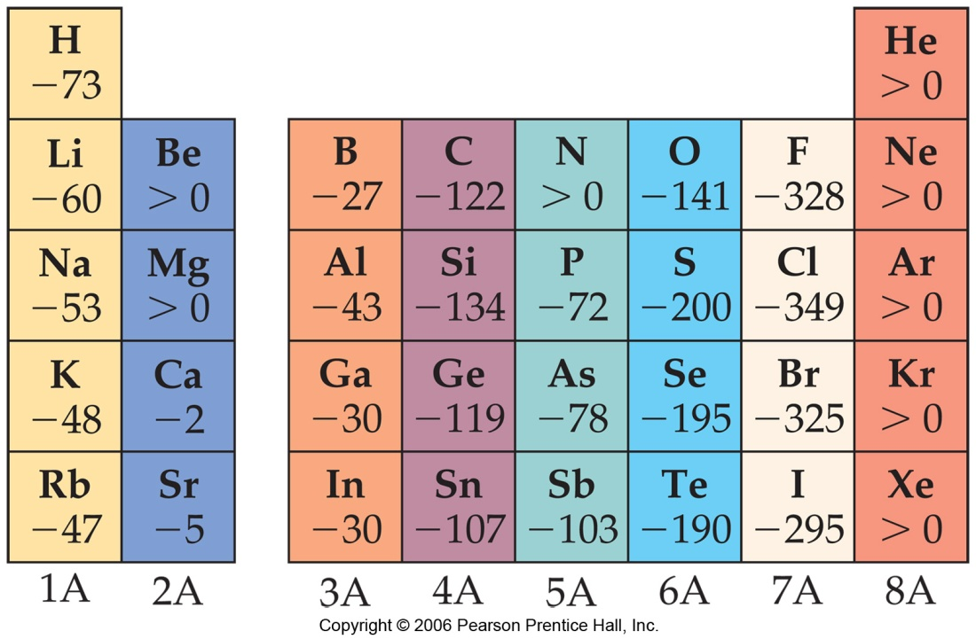
Trends in Electron Affinity
There are again, however, two discontinuities in this trend.

Slide 36
Trends in Electron Affinity
The first occurs between Groups IA and IIA.
  The added electron must go in a p-orbital, not an s-orbital.
  The electron is farther from nucleus and feels repulsion from the s-electrons.

Slide 37
Trends in Electron Affinity
The second occurs between Groups IVA and VA.
  Group VA has no empty orbitals.
  The extra electron must go into an already occupied orbital, creating repulsion.

Slide 38
Summary of Trend
Periodic Table and Periodic Trends
1. Electron Configuration
3. Ionization Energy: Largest toward NE of PT
4. Electron Affinity: Most favorable NE of PT
2. Atomic Radius: Largest toward SW corner of PT

Slide 39
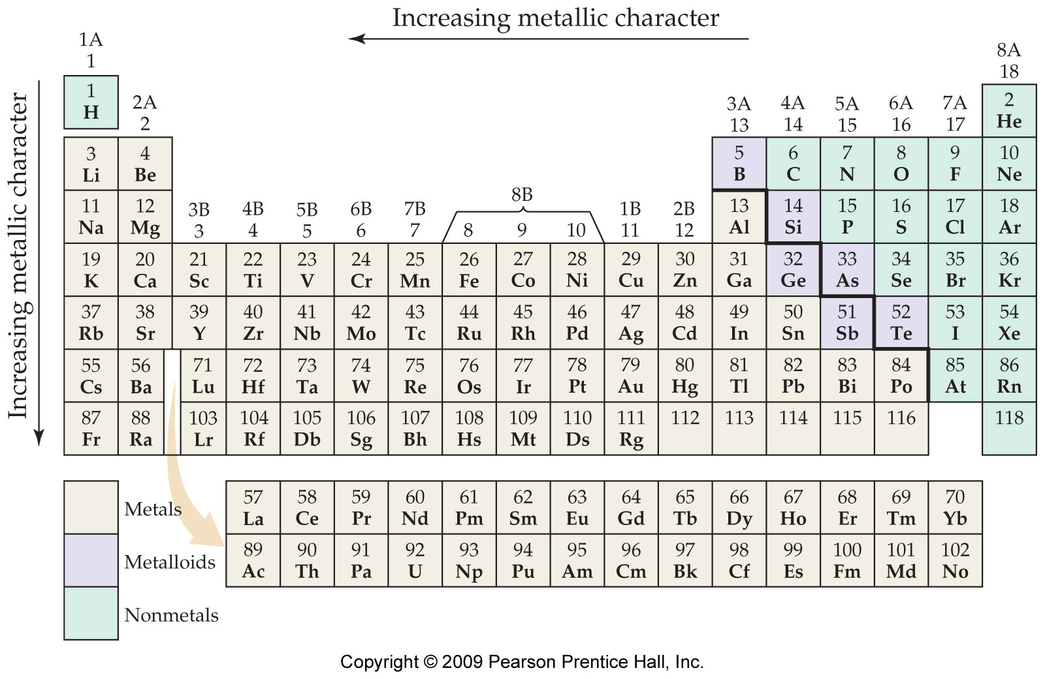
Properties of Metal, Nonmetals, and Metalloids

Slide 40
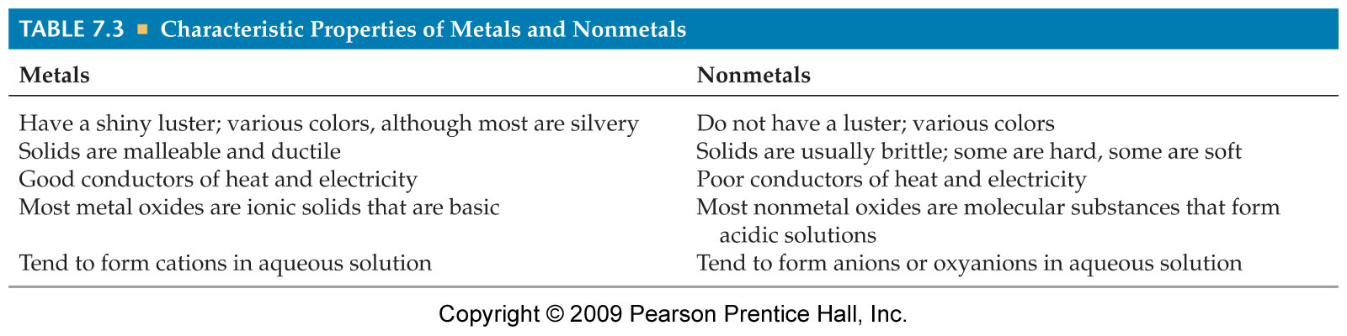
Metals versus Nonmetals

Slide 41
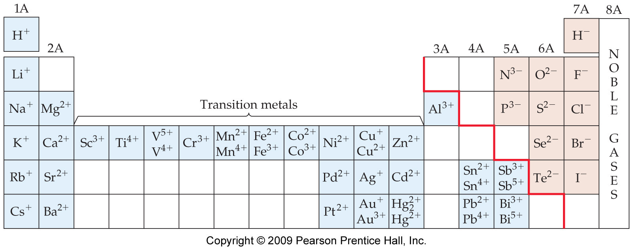
Metals versus Nonmetals
Metals tend to form cations.
Nonmetals tend to form anions.

Slide 42
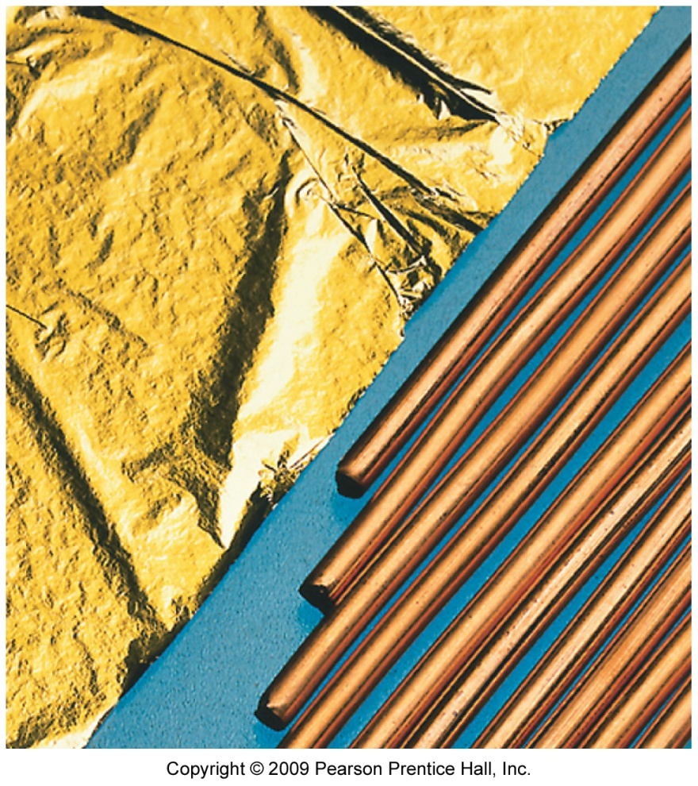
Metals
They tend to be lustrous, malleable, ductile, and good conductors of heat and electricity.

Slide 43
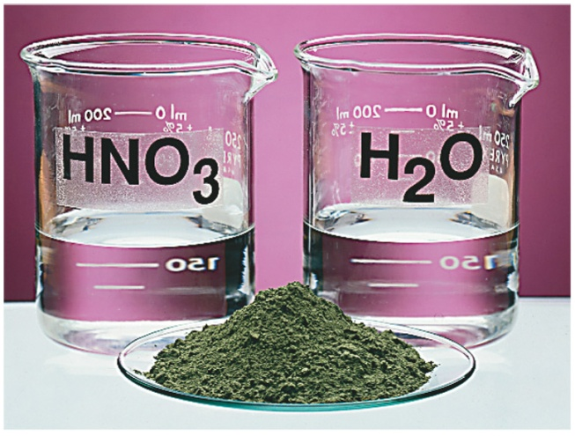
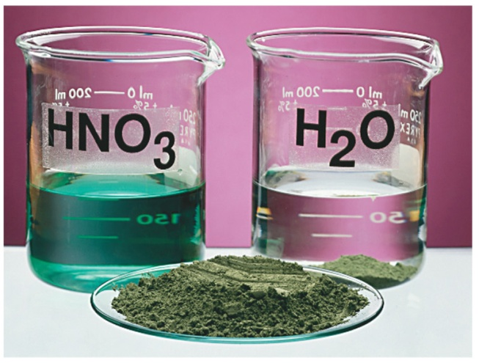
Metals
Compounds formed between metals and nonmetals tend to be ionic.
Metal oxides tend to be basic.

Slide 44
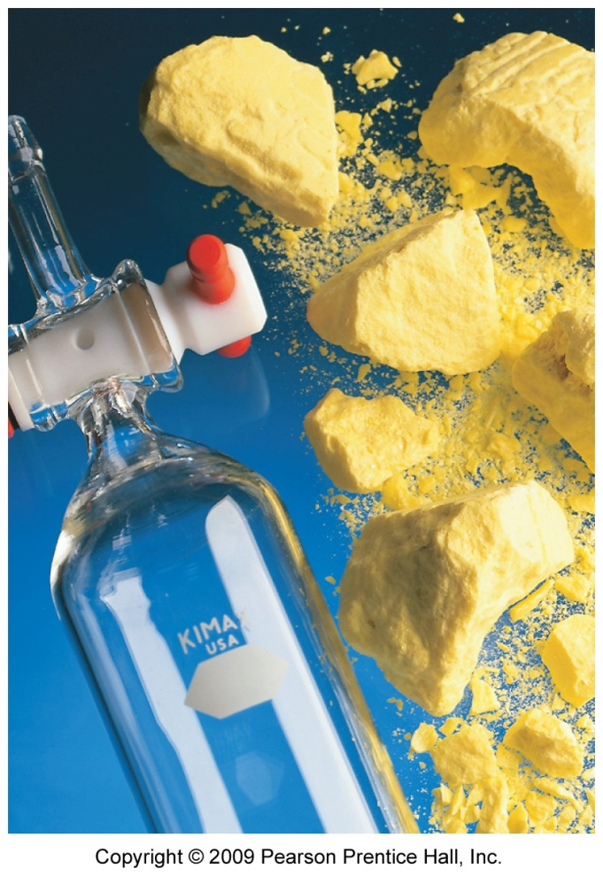
Nonmetals
These are dull, brittle substances that are poor conductors of heat and electricity.
They tend to gain electrons in reactions with metals to acquire a noble gas configuration.

Slide 45
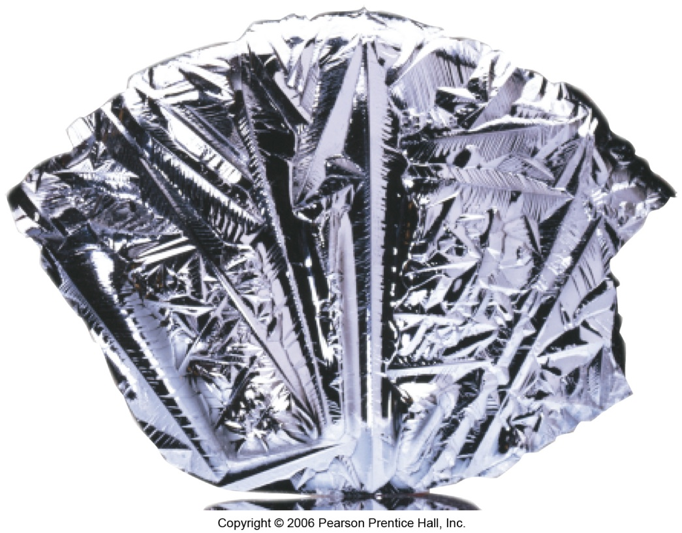
Metalloids
These have some characteristics of metals and some of nonmetals.
For instance, silicon looks shiny, but is brittle and fairly poor conductor.

Slide 46
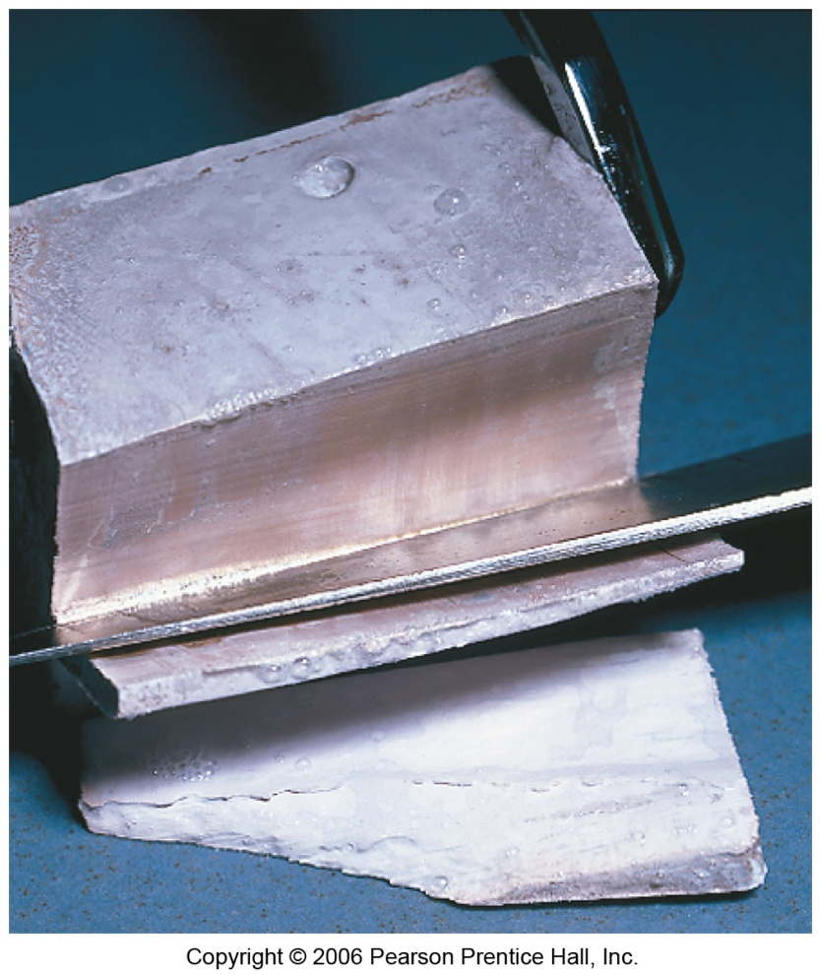
Alkali Metals
Alkali metals are soft, metallic solids.
The name comes from the Arabic word for ashes.

Slide 47
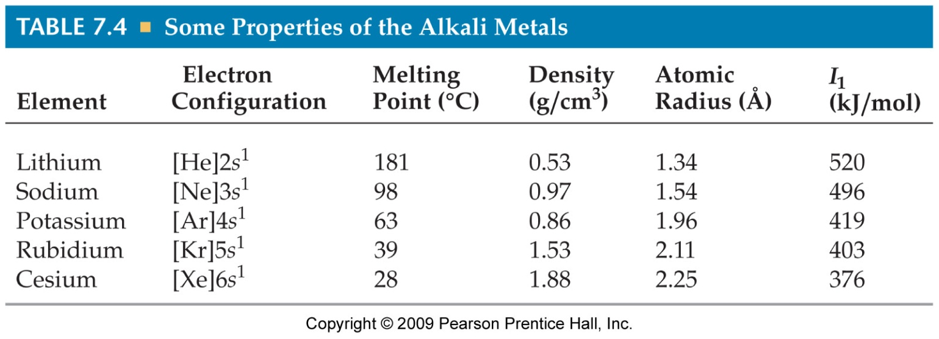
Alkali Metals
They are found only in compounds in nature, not in their elemental forms.
They have low densities and melting points.
They also have low ionization energies.

Slide 48
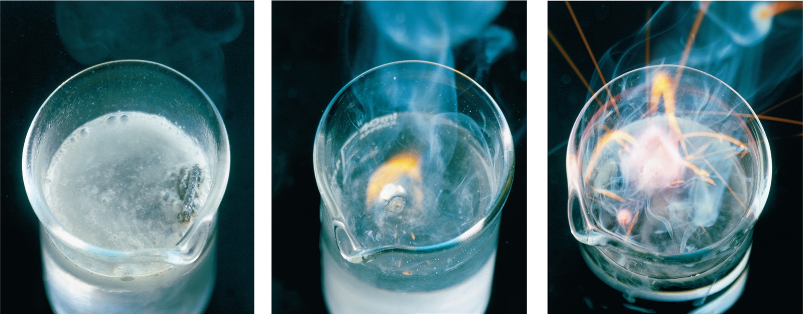
Alkali Metals
Their reactions with water are famously exothermic.

Slide 49
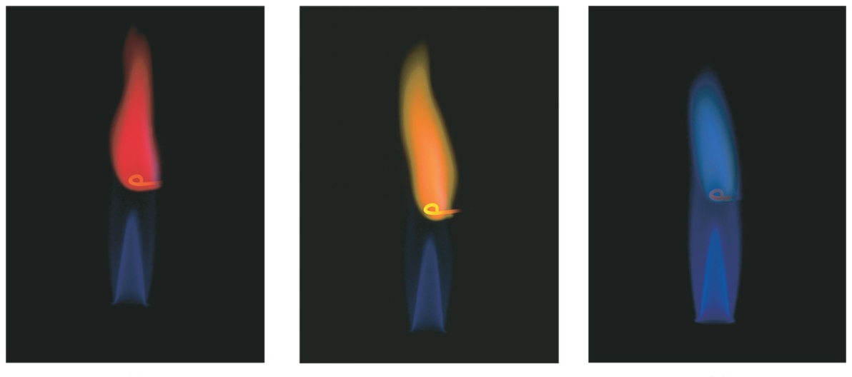
Alkali Metals
Alkali metals (except Li) react with oxygen to form peroxides.
K, Rb, and Cs also form superoxides:
K + O₂ ⎯⎯→ KO₂
They produce bright colors when placed in a flame.

Slide 50
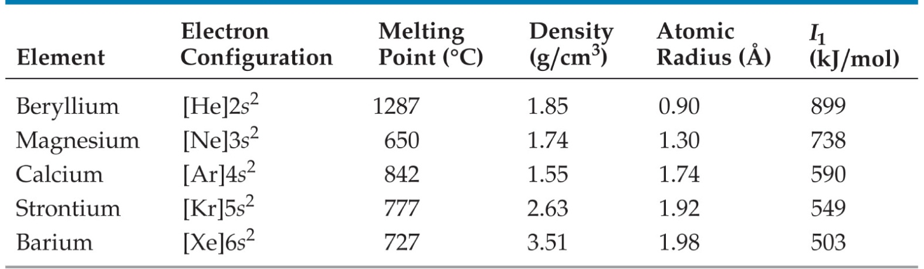
Alkaline Earth Metals
Alkaline earth metals have higher densities and melting points than alkali metals.
Their ionization energies are low, but not as low as those of alkali metals.

Slide 51
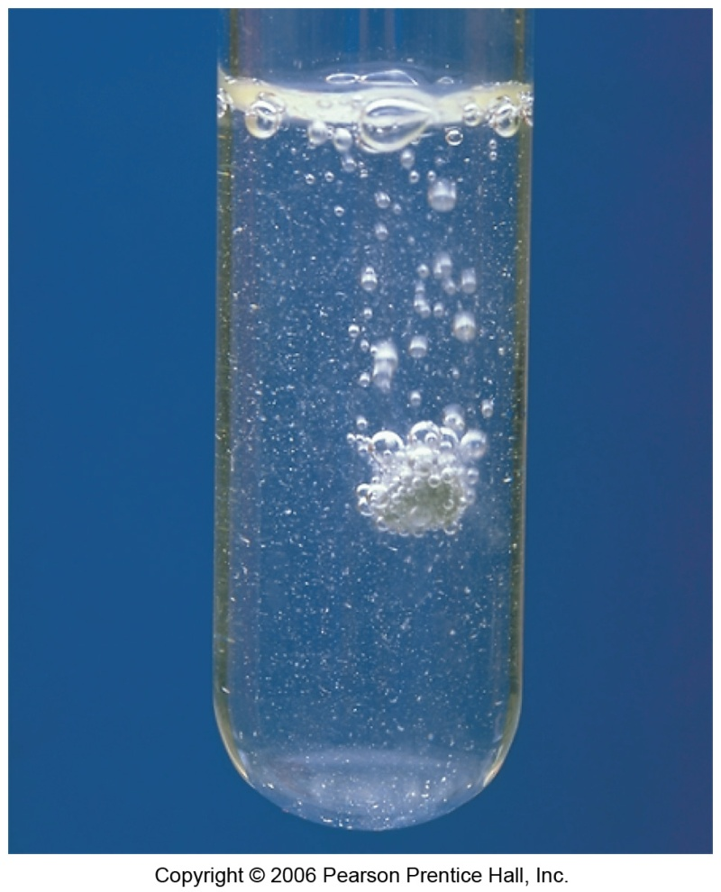
Alkaline Earth Metals
Beryllium does not react with water and magnesium reacts only with steam, but the others react readily with water.
Reactivity tends to increase as you go down the group.

Slide 52
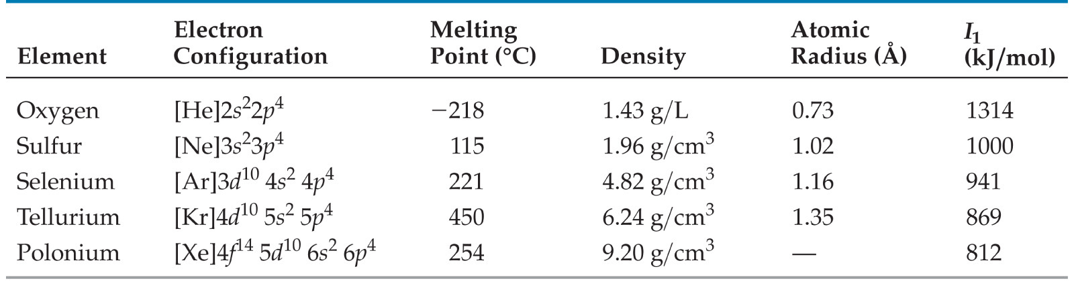
Group 16
Oxygen, sulfur, and selenium are nonmetals.
Tellurium is a metalloid.
The radioactive polonium is a metal.

Slide 53
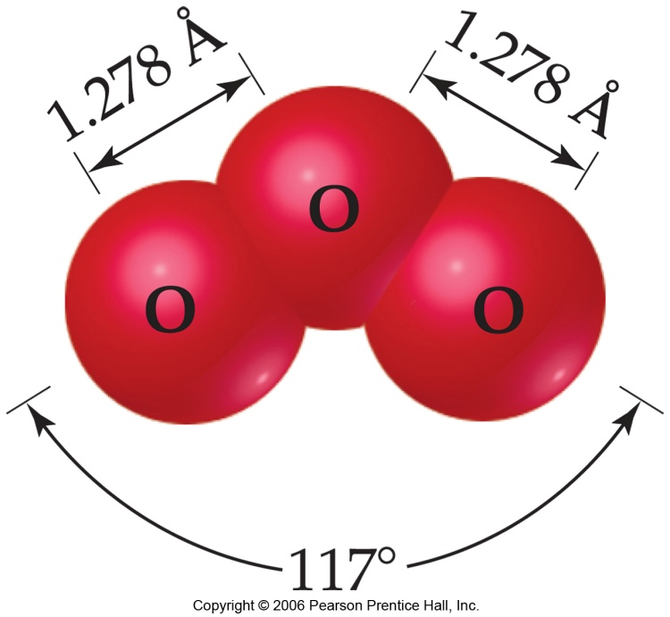
Oxygen
There are two allotropes of oxygen:
  O₂
  O₃, ozone
There can be three anions:
  O²⁻, oxide
  O₂²⁻, peroxide
  O₂¹⁻, superoxide
It tends to take electrons from other elements (oxidation).

Slide 54
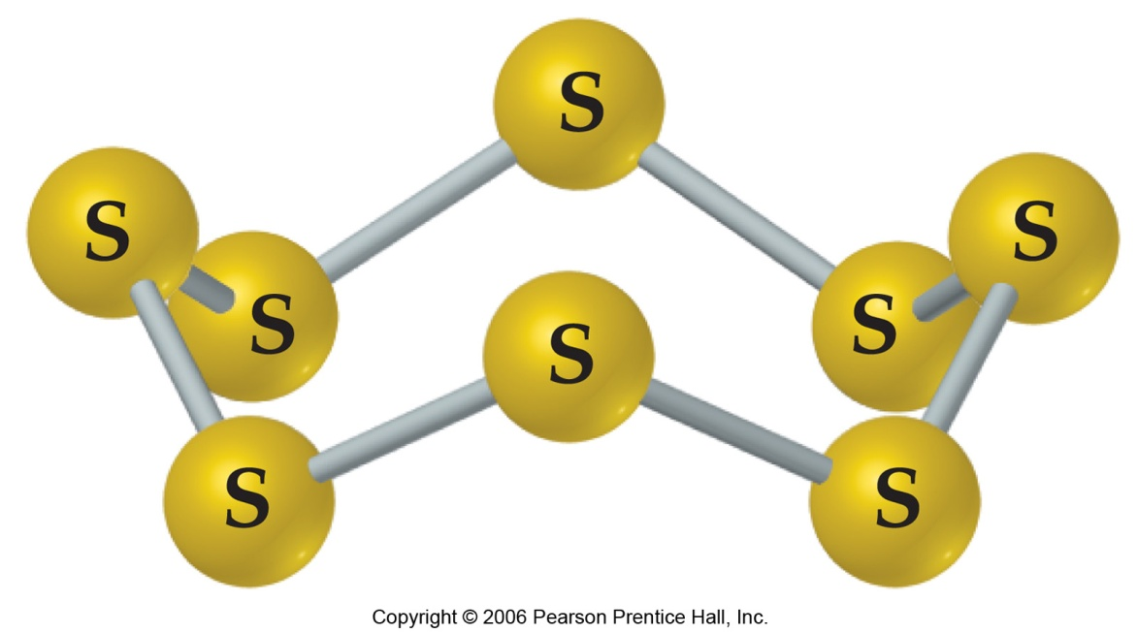
Sulfur
Sulfur is a weaker oxidizer than oxygen.
The most stable allotrope is S₈, a ringed molecule.

Slide 55
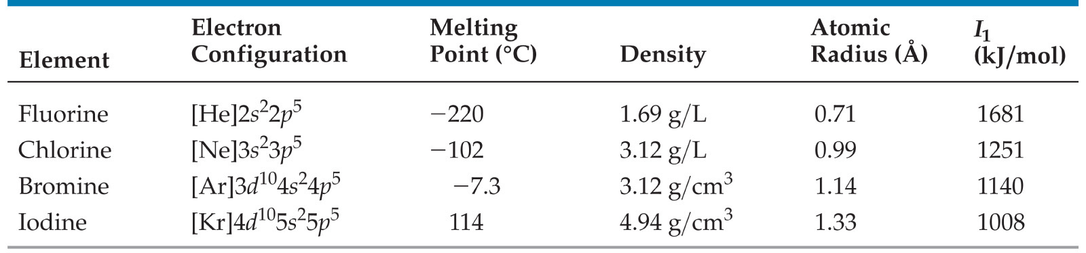
Group 17: Halogens
The halogens are prototypical nonmetals.
The name comes from the Greek words halos and gennao: “salt formers”.

Slide 56
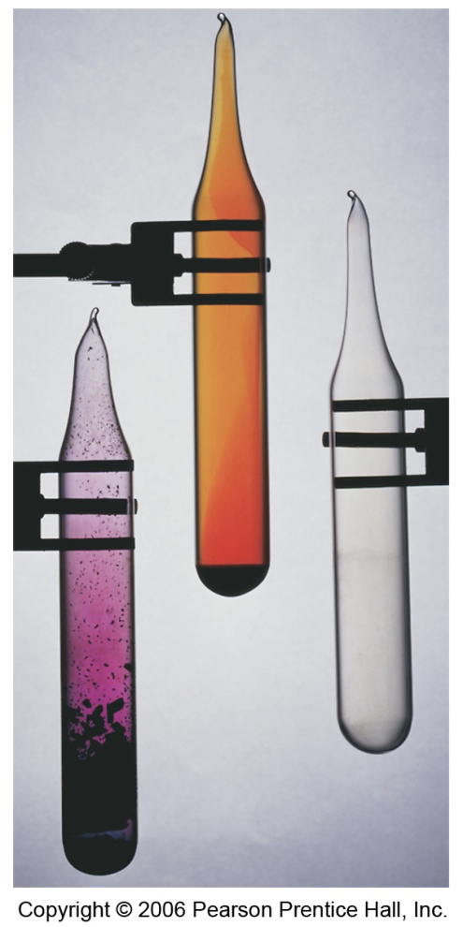
Halogens
They have large, negative electron affinities.
  Therefore, they tend to oxidize other elements easily.
They react directly with metals to form metal halides.
Chlorine is added to water supplies to serve as a disinfectant

Slide 57
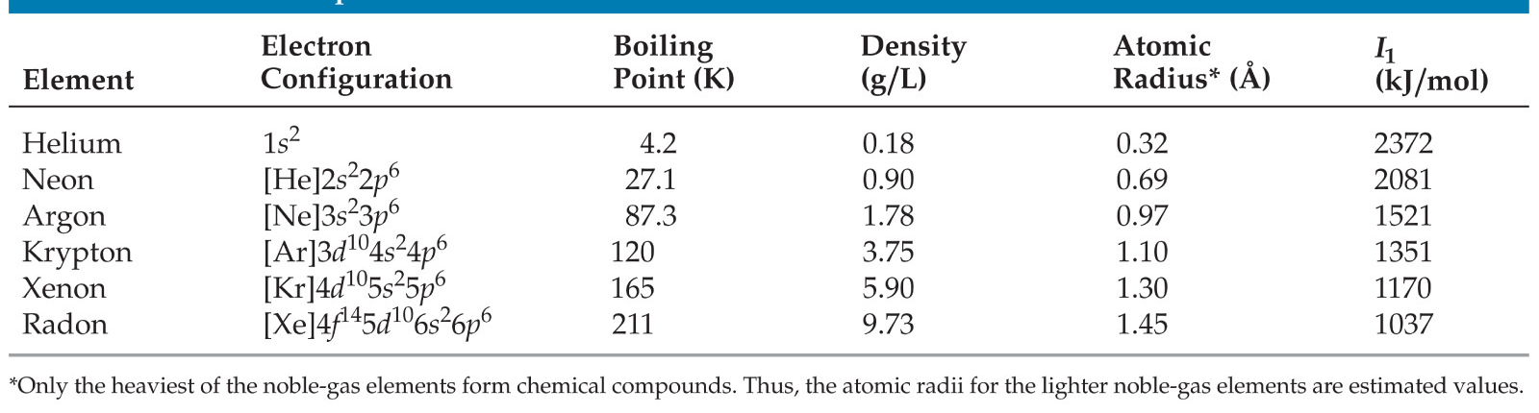
Group 18: Noble Gases
The noble gases have astronomical ionization energies.
Their electron affinities are positive.
  Therefore, they are relatively unreactive.
They are found as monatomic gases.

Slide 58
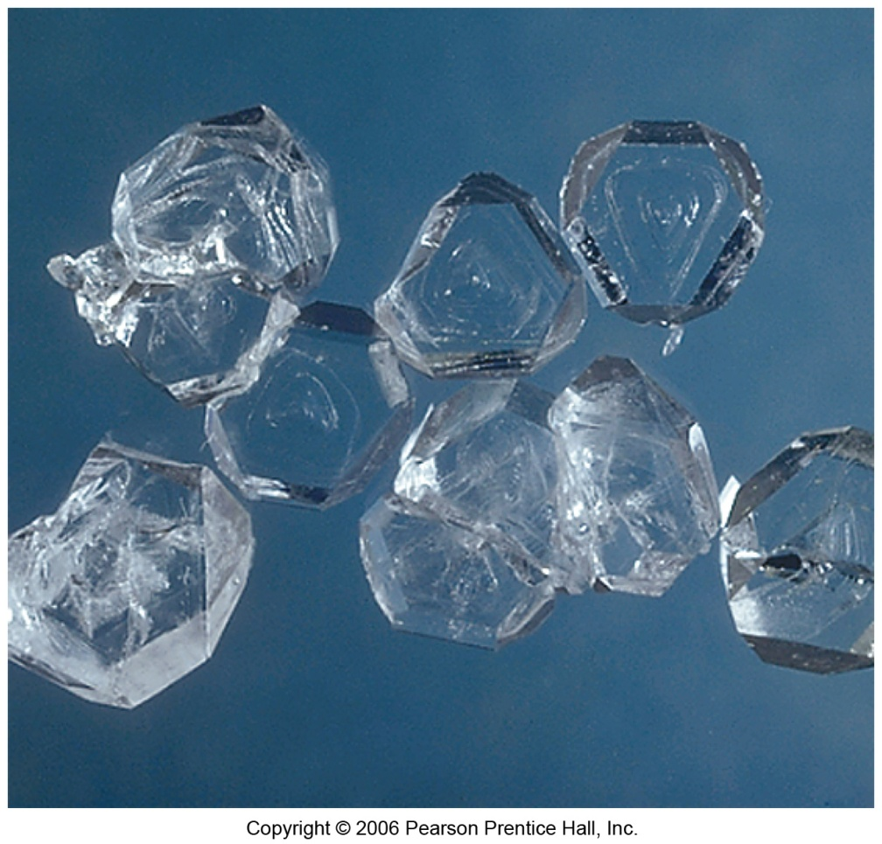
Noble Gases
Xe forms three compounds:
  XeF₂
  XeF₄ (at right)
  XeF₆
Kr forms only one stable compound:
  KrF₂
The unstable HArF was synthesized in 2000.

